Slide 1



Slide 2
Our Mission
“…wield technology's wonders to raise health care's quality and lower its cost."
- President Obama’s 1st Inaugural

Slide 3

- President Obama
Work with Providers & Payers
  To Understand Population Health Challenges
    Leverage Geospatial Tech
        Clinician Point-of-Care Decision Support
            Reduce System Costs
              And Improved Outcomes

Slide 4
Our Approach
Identify & Merge Data Sources
That Provide Unique Insights
And Suggest Novel Approaches
To Address Population Health Challenges

Slide 5


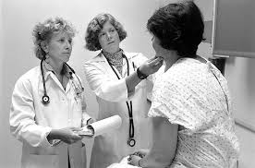
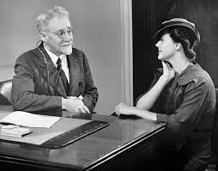


Doctors Diagnose Patients

Slide 6




Diagnosis Includes Families

Slide 7

Population Health Now Focus

Slide 8

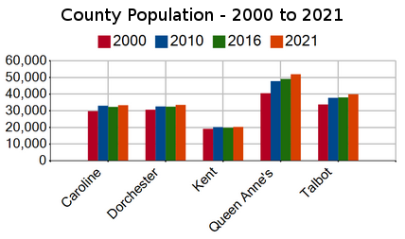

Social Determinants of Health…
…Location is the Connector
Geographic
  Urban/Rural
  Food Deserts
Demographic
  Population/Age
  Households
  Education
  Employment
Health
  Facility location
  Current & past year’s claims data
  Global budget data
  ER utilization
  Readmission rates
  Patient characteristics

Slide 9

The Challenge
Address Population Health Challenges –

Slide 10
The Challenge
Address Population Health Challenges –

Slide 11
The Challenge
Readmissions Reduction–
  Engage Discharged Patients
  To Keep Them Out of the Hospital

Slide 12
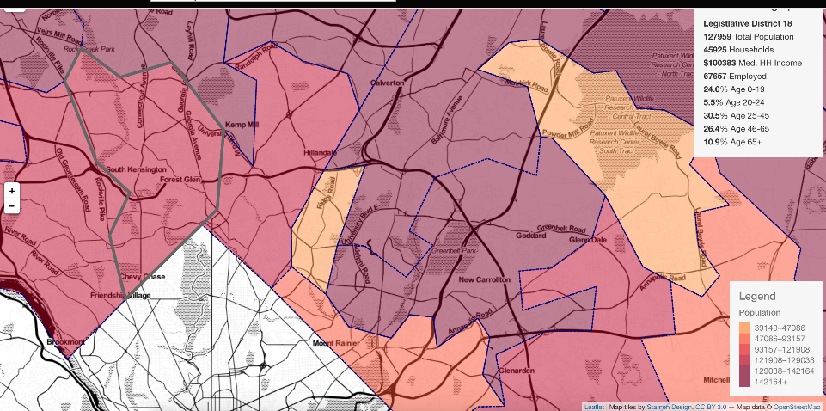

ER & Discharges…by Address
Cluster of patients discharged from ER, hospital

Slide 13
Mobile Van Routes…Option 1: All Patients

Slide 14
Mobile Van Routes…Option 2: Patients with Greatest Risk of Readmission

Slide 15
Mobile Van Routes…Option 3: By Patient Condition

Slide 16
The Benefits
25%-55% Drop in Readmissions Possible
  Dynamic routing improves hospital’s ability to engage patients & the community they serve
  Allows hospitals to make day-by-day decisions on which patients most need outreach

Slide 17
The Challenge
Address Population Health Challenges –

Slide 18
UM Shore Regional Health: Mid-Shore Region

Slide 19
Population Coverage with 2nd Cancer Center
Combined: Coverage Close to 100%

Slide 20
Population Coverage with 2nd Rehab Facility
Combined: Coverage Close to 100%

Slide 21
Healthcare Access: Medical Facility Location
Expand Analysis to Include Additional Factors
  Age
  Employment
  Education levels
  Income
  Available transit options
  Zoning considerations
  Available medical office & facility space
  Medical conditions
Analysis can also Consider Shorter Drive Time

Slide 22
The Challenge
Address Population Health Challenges –

Slide 23
The Challenge
Assess Capacity of Healthcare System –
  Does the Health System
  Have Sufficient Capacity to
  Address the Health Concerns
  Expected from the Population

Slide 24
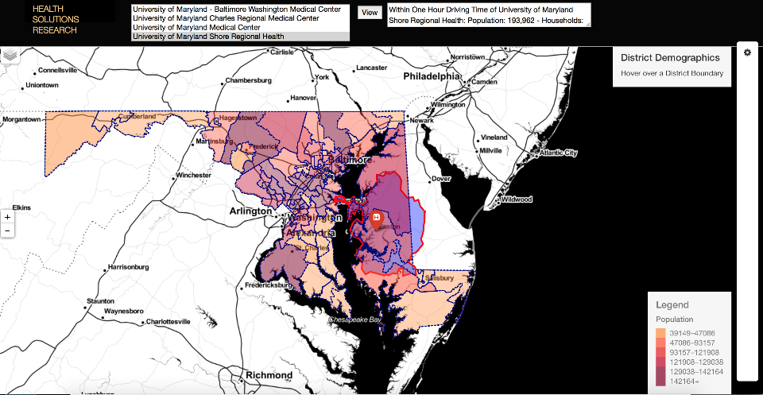
Health System Capacity Map
Cancer Patients: 897
Capacity: 650
Compares Hospital or Health System Capacity within Individual Service Lline with the Incident Rate of Illness within 1-hour Drive Time.

Slide 25
The Challenge
Address Population Health Challenges –

Slide 26
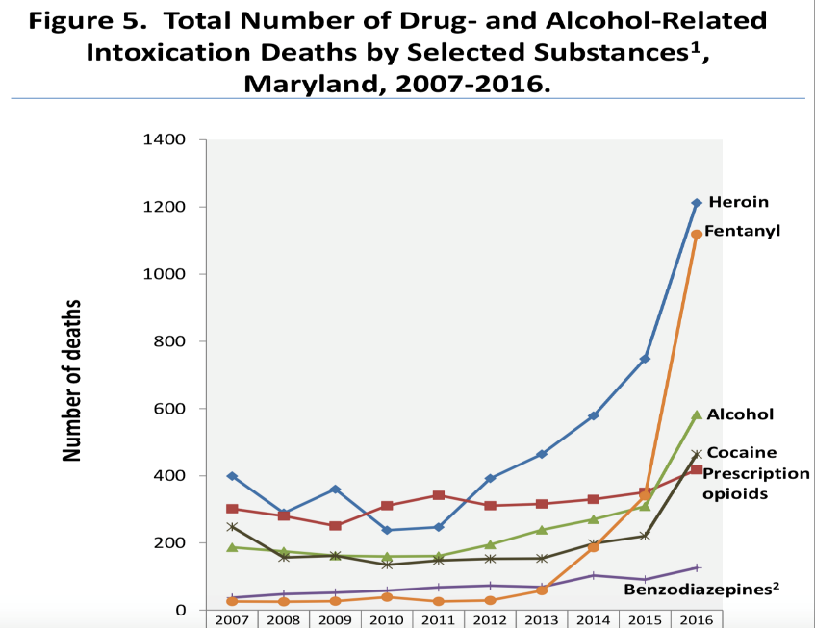
Opioid Fatalities by Substance, 2007-2016

Slide 27
The Challenge
Opioid Epidemic –
  Identify Patients at Risk of Overdose, Addition, Diversion
  Track Flow of Prescription & Illegal Opioids
  Identify the Resources Needed to Truly Fight this Epidemic

Slide 28
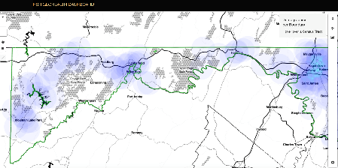
Opioid Heat Map Output
Medical Community
  Patient risk stratification
  Provide Point-of-Care decision support
  Help clinician identify signs of addiction, diversion
Law Enforcement Community
  Identify special correlations between drug sources and drug incidents
  Correlate legal & illegal drug flow with crime incidents
Community & Social Services Organizations
  Target addiction counseling services to areas of greatest need
  GeoCoding patients of high/medium risk

Slide 29
Opioid Heat Map – Hot Zones Construction

Slide 30
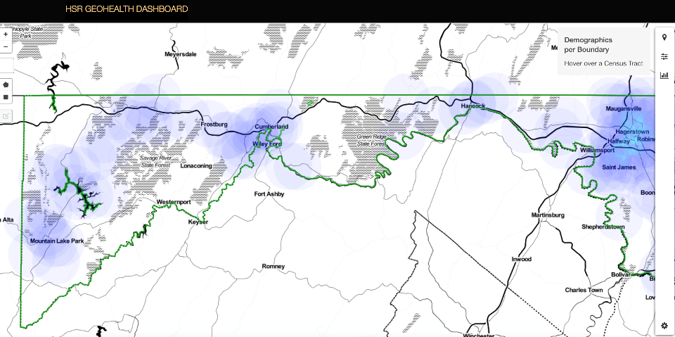
Opioid Heat Map – Hot Zones Construction
PDMP Data

Slide 31
Opioid Heat Map – Hot Zones Construction
Overdose related incidents
#Blitzed up real good on percs. Luvin life.
PDMP Data

Slide 32
Opioid Heat Map – Hot Zones Construction
Overdose related incidents
#Blitzed up real good on percs. Luvin life.
PDMP Data

Slide 33
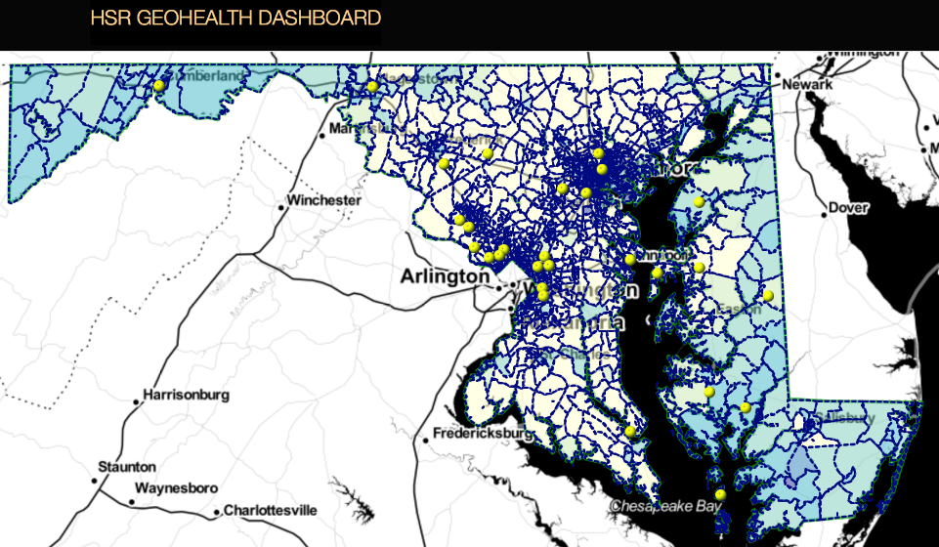
Opioid Heat Map – Hot Zones

Slide 34
OARM / GeoCoding Validation – EHR Data
  Measure the predictive performance of the OARM on de-identified and historic EHR data.
    Compare the performance of OARM on a separate clinical data warehouse (CDW).
  Evaluate whether the risk groups identified by the prediction tool are associated with differential outcomes from the viewpoint of opioid related mortality.
  Our working hypotheses:
    Geospatial and ML-based prediction tools will out-perform the other approaches.
    Patients classified as high risk will have worse outcomes overall
    Patients classified as high risk and who received the intervention will have better outcomes than high risk patients in the control group.

Slide 35
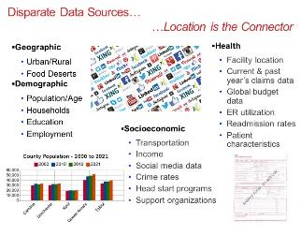

GeoHealth Dashboard Data Flow – Geocode Data
HSR
Database
GeoCode

Slide 36

GeoHealth Dashboard Data Flow – Manage Data
HSR
Database
HSR
Database
GeoCode

Slide 37

GeoHealth Dashboard Data Flow – Analyze Data
HSR
Database
HSR
Database
Analytic
Engine
GeoCode

Slide 38

GeoHealth Dashboard Data Flow – Process Data
HSR
Database
HSR
Database
GeoHealth
Dashboard
Analytic
Engine
GeoCode

Slide 39
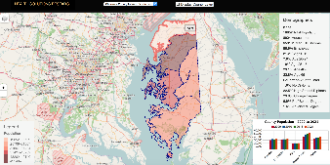
GeoHealth Dashboard Data Flow – Map Data
HSR
Database
HSR
Database
GeoHealth
Dashboard
Analytic
Engine
GeoCode
39

Slide 40
Clinician Point of Care Decision Support
  Leveraging Hospital EHR Data

Slide 41
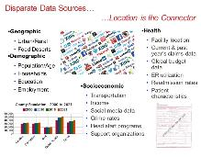

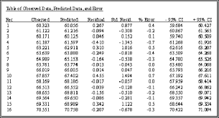
GeoHealth Dashboard Data Flow – Process Data
HSR
Database
Unstructured-NLP

Slide 42
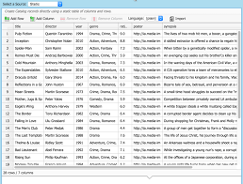
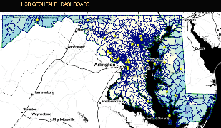
GeoHealth Dashboard Data Flow – Map Opioid Data
HSR
Database
GeoHealth
Dashboard
Analytic
Engine

Slide 43
Merging OARM & Opioid Heat Map
OARM
HSR
Database
GeoHealth
Dashboard
Analytic
Engine

Slide 44
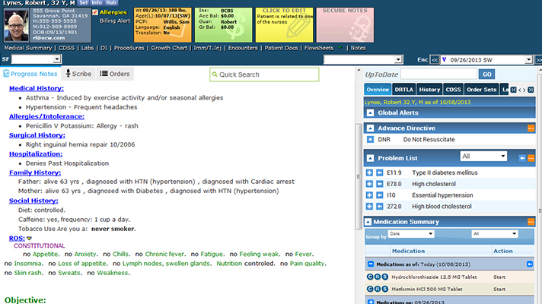
Risk Score at Point-of-Care
Risk Score reported to Clinician within EHR
Risk Score:
HIGH

Slide 45
Risk Score at Point-of-Care
High Risk

Slide 46
Opioid Abuse Related Mortality
  Sensitivity 0.70 in predicting mortality
  Especially effective for age cohort 45-54
  More useful than self reported risk stratification tools in identifying patients at high risk of opioid related mortality

Slide 47
Benefits
Clinical
Save 12 minutes physicians spend on average in diagnosis of opioid patients
Reduce unnecessary prescriptions
Reduce opioid-related admissions, complications, readmissions
Lives Saved =
Stronger Families =
Better Communities
Social
Improved productivity
Increased tax revenues
Economic

Slide 48
Benefits
Clinical
Lives Saved =
Stronger Families =
Better Communities
Reduce Child Care &
Education spending by $4K per addict
Social
Save 12 minutes physicians spend on average in diagnosis of opioid patients – Save $400/minute
Reduce unnecessary prescriptions – Save $6000-$14,000 per year
Reduce opioid-related admissions, complications, readmissions – Save $12,900 per patient
Save $800,000 to GDP per life saved
Improved productivity – Saves $20,500 per employee
Increased tax revenues – Save up to $8,000 per person in tax revenues
Economic

Slide 49
Benefits to All of US
Who | How – Cost Savings & Productivity Gains
Providers | $400/minute saved diagnosing patient; Clinician time saved per opioid-related patient visit, safer workplace environment
Payers | Over $20,000 per year per patient; Reduced prescription drug costs, treatment costs for direct and induced conditions
People | Get their Lives Back
Employers | $20,500 per epidemic-impacted employee per year; Reduced OUD among workforce, increase ability to hire
Government | $8,000 per addiction sufferer per year; Increased direct tax revenues
Nation | $800,000 per reduced fatality; Improved families and communities, reduced strain on social safety net

Slide 50
Patient Risk Stratification for Opioid Abuse Related Mortality
  Presented @ Machine Learning, Big Data, & AI in Healthcare Conference, May 2018
  Entered the Robert Wood Johnson Foundation Funding Challenge, Opioids and AI
  Preparing for Clinical Trials
    Holy Cross Health
    Loyola University Medical College
  Authoring Chapter in Upcoming Healthcare Technical Publication: “Analytics, Operations, and Strategic Decision Making in the Public Sector”

Slide 51
Thank You
Questions ??
Ajay K Gupta, CISSP, MBA
CEO
240-731-0756
agupta@healthsolutionsresearch.org
June 22, 2018
@HealthSolnRsrch | Check out our Health Access Blog.

Slide 52
GeoAnalytic Dashboard… A Sampling of Applications
To study Population Demographics
For the purposes of conducting a Transportation Study
    Resulted In: Non-emergency Medical Transportation plan
Locations of Medical Facilities
    Resulted In: Healthcare Treatment Capacity Analysis
Hospital-centric Geographic Regions for Cost Containment
Opioid Epidemic Heat Map

Slide 53
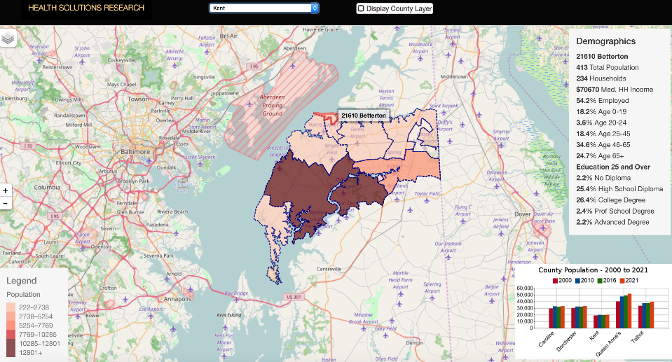
Social Demographics of Health…by Zip Code

Slide 54
The Challenge
Address Population Health Challenges –

Slide 55
Background
Creating Actionable Knowledge from Population Health Data
  Outpatient & Inpatient
  For healthcare cost management
Three Different Perspectives
  How IT bridges the gap to bring knowledge to the clinician
  How real-time data improves in-hospital clinical decision making

Slide 56
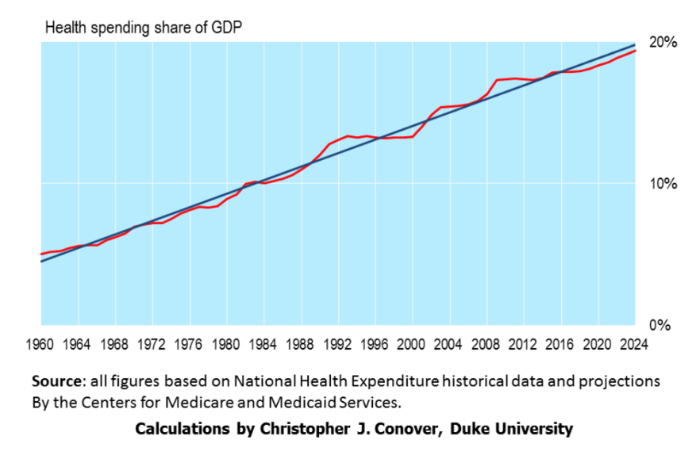
Medicare Cost Curve

Slide 57
Improve Outcomes Through Cost Management
Track Population
  Overall
  Service Delivery Area
  Those Visiting Hospital
Track the Social Determinants of Health
Anticipate Illnesses & Medical Conditions
Prepare for Care Delivery & Associated Costs

Slide 58
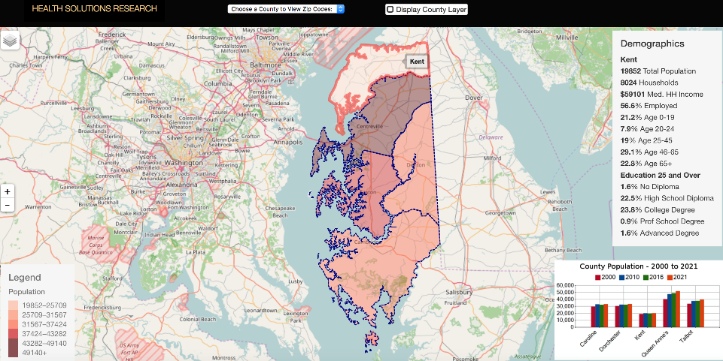
Population Demographics & SDH…by County
Select Individual County Here to See Zip Code Data

Slide 59
Population Demographics & SDH…by Zip Code

Slide 60
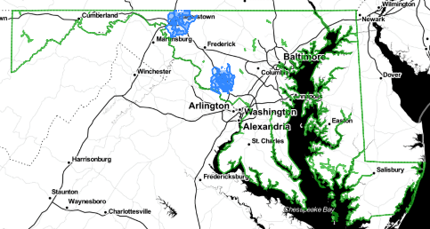
Geographic Regions for Cost Management
Geographic Regions
  Initial creation
  Track spend long term
  Adjust regions to reflect population shifts
  Visualize data
Patient Risk Stratification
  Based on hospital HCC coding
  Illness rates
  Now can include additional factors not previously available or considered

Slide 61
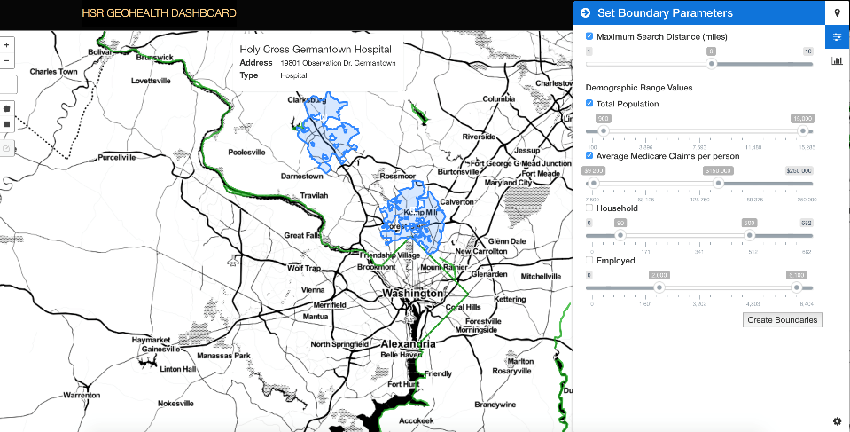
Geographic Regions for TCOC Containment

Slide 62
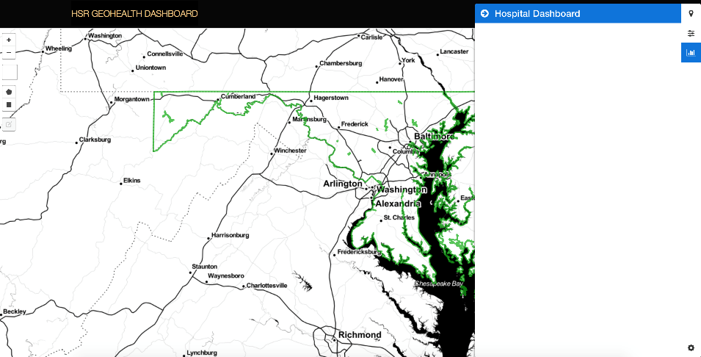
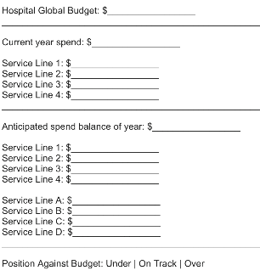

Geographic Regions for TCOC Containment

Slide 63
Leading Indicator of OD Fatality
  Suspected Indicator of OD: 1 or more Near Overdose
    858 OD fatalities in Maryland (2013)
  59% had at least 1 or more visits for an OD during year prior to the OD fatality
    N=502
    Total overdose visits = 1,507
  66% had at least 1 or more visits for any reason up to one year prior to the OD fatality
    n=570
    Total visits = 2,207
  A higher proportion of patients had multiple visits for reasons not immediately deemed an OD
    Opioid related complication?
    Did hospitalization involve use of high dose opioid medications?
    Near miss during hospitalization?​

Slide 64
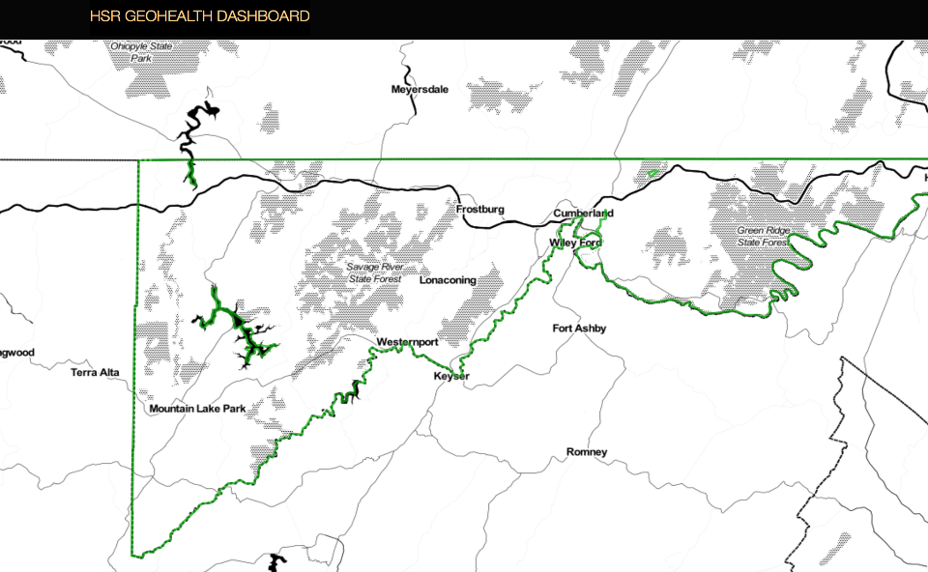
Opioid Heat Map – Time Sequence of Events
Drugs sold
Incidents occurred
Prescriptions written
3
10

Slide 65
Opioid Heat Map – Time Sequence of Events
Drugs sold
Incidents occurred
Prescriptions written
3
10

